Slide 1

Predicting Customer Churn for a Telecom Company
This presentation discusses the development of a predictive model to identify customers at risk of churn in an Iranian telecom company, with a focus on achieving high ROC-AUC and F1 scores.

Slide 2
Introduction
Problem Statement: customer churn presents a significant challenge to seeking sustained growth and profitability.
Criteria for Success:
High ROC-AUC and F1 scores
Effective handling of imbalanced data
Actionable insights
Stakeholder satisfaction

Slide 3

Data
Randomly collected data from an Iranian telecom company's database over 12 months.
14 columns

Slide 4
Data Wrangling and Cleaning
Biggest takeaways:
Wide range of call failures
More no complaints than complaints
Average age of customers was 30.99
Imbalanced target variable: 2655 customers did not churn, 495 customers churned.

Slide 5
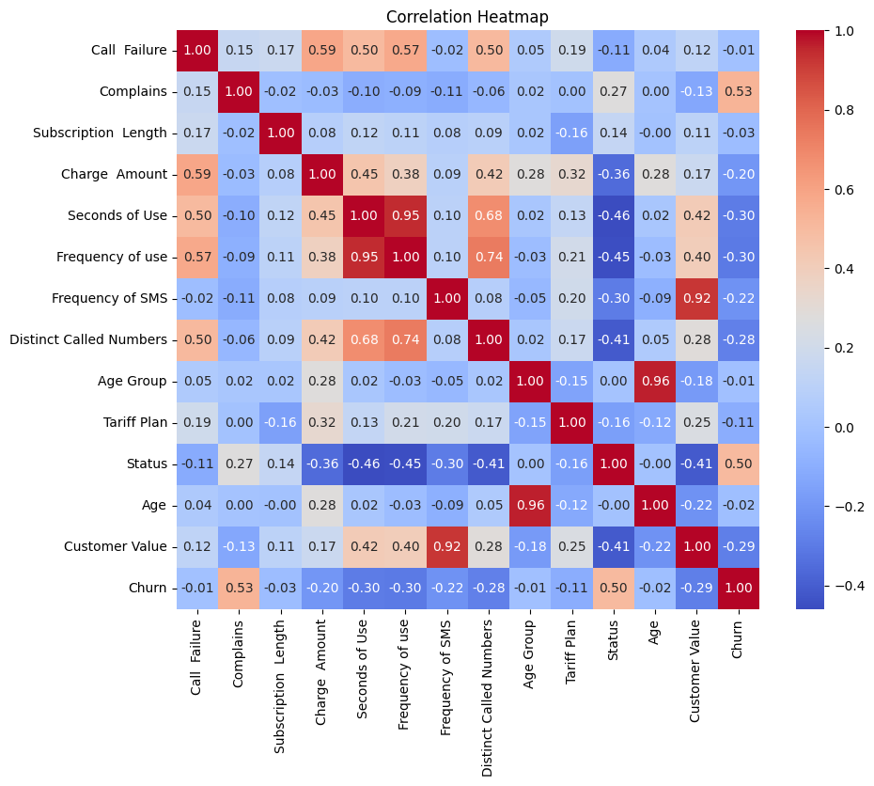
Exploratory Data Analysis

Slide 6
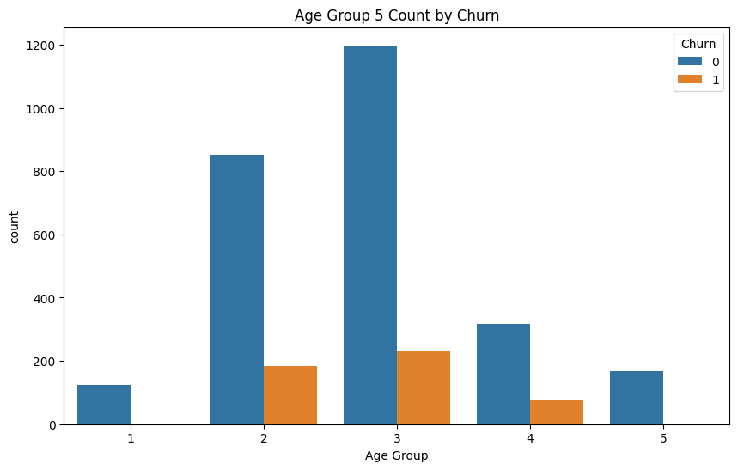
Exploratory Data Analysis

Slide 7
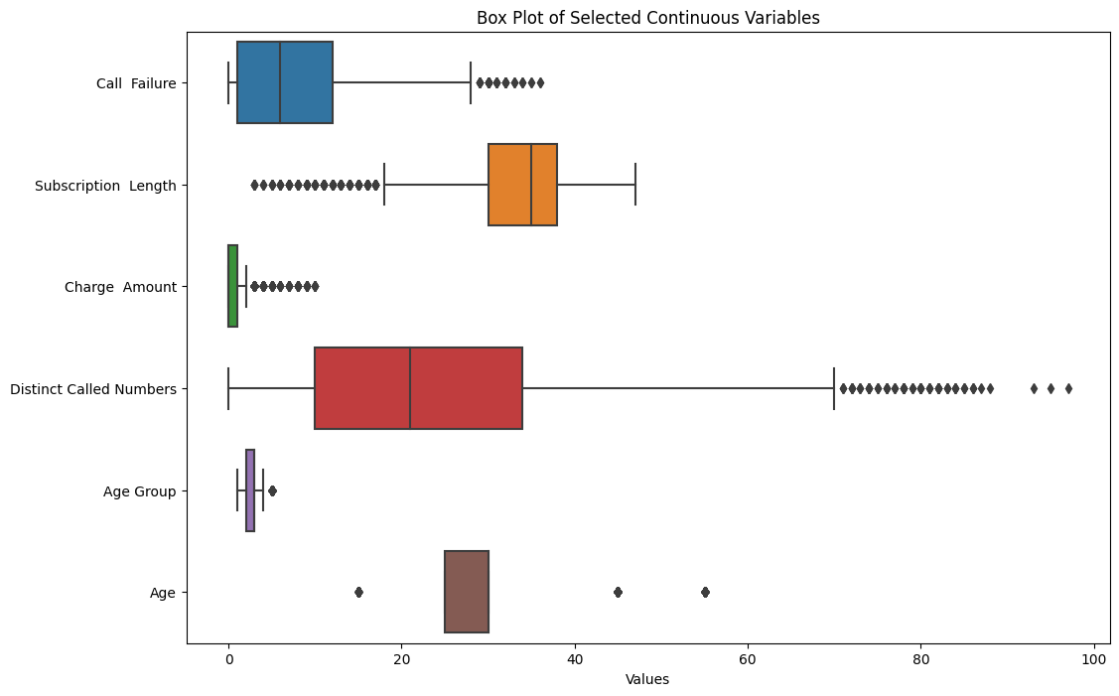
Exploratory Data Analysis

Slide 8
Modeling Phase
Logistic regression
Random Forest
Support Vector Machine
Gradient Boosting
Gradient Boosting demonstrated superior performance in ROC-AUC and F1 scores.
Balanced trade-off between precision and recall on the imbalanced churn dataset.

Slide 9

Recommendations
Tailored Retention Strategies
Proactive Customer Engagement
Segmented Marketing Campaigns
Enhanced Customer Experience
Churn Prediction Monitoring
Data Enrichment and Feature Engineering
Employee Training and Support
Long term Customer Value

Slide 10
Thank you for your time. Feel free to ask any questions 😊

